Slide 1
Environmental Issues of Bengaluru
(w.r.t Air Quality)
February 27, 2015
Sh. S. Suresh, Zonal Officer & Smt. Mahima T, Environmental Engineer
Central Pollution Control Board, Bengaluru
www.cpcb.nic.in

Slide 2
Central Pollution Control Board
Statutory organisation under MoEF
Constituted in September, 1974
Apex body for pollution control in India
Head office in Delhi, with seven zonal offices
Advise the Central Government on any matter concerning prevention and control of water and air pollution and improvement of the quality of air.
Execution of nation-wide programs for the prevention, control or abatement of water and air pollution;
Dissemination of Information

Slide 3
About South Zonal Office, Bengaluru…
Estd October 1988
Jurisdiction of Karnataka, Tamil Nadu, Kerala, Andhra Pradesh, Telangana & Goa, Pondicherry and Lakshadweep
Covers area 639474 Sq km and coastal stretch of 3025 km.

Slide 4
Important activities
Surveillance of air and water quality monitoring stations
Inspection of industries under ESS
Interstate river monitoring
Organisation of Mass awareness programme
Inspection of laboratories for recognition
Co-ordination with all concerned SPCB’s/PCC’s/ organizations engaged in Pollution Control Activities
Review of critically polluted areas
Monitoring of STP’s, CETP’s, TSDF, HCE’s, CBMWTF’s,

Slide 5
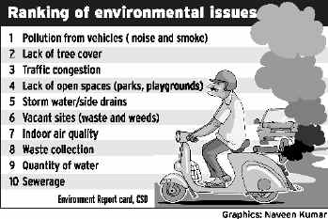
Environmental Issues in Bengaluru

Slide 6
Bengaluru
Area 741 Sqkm
population of about 8.42 million
Population density per sqkm 11371
residential areas around 40.4%, industrial-6.9%, commercial-2.7, Transport/ roads- 24.3%, green cover 21.5, others 4.2%
Around 270 large and medium scale industries and around 70,000 SSI
Consumption/capita/year
Lpg-30kg, diesel-57.9 liter, petrol-39.4liter
Vehicle Population in Bengaluru City (up to 30-11-2014)
Two wheelers | LMV | A/R | HTV | HGV | Others | Total
3725435 | 110297 | 146481 | 112914 | 72442 | 232598 | 5392847

Slide 7
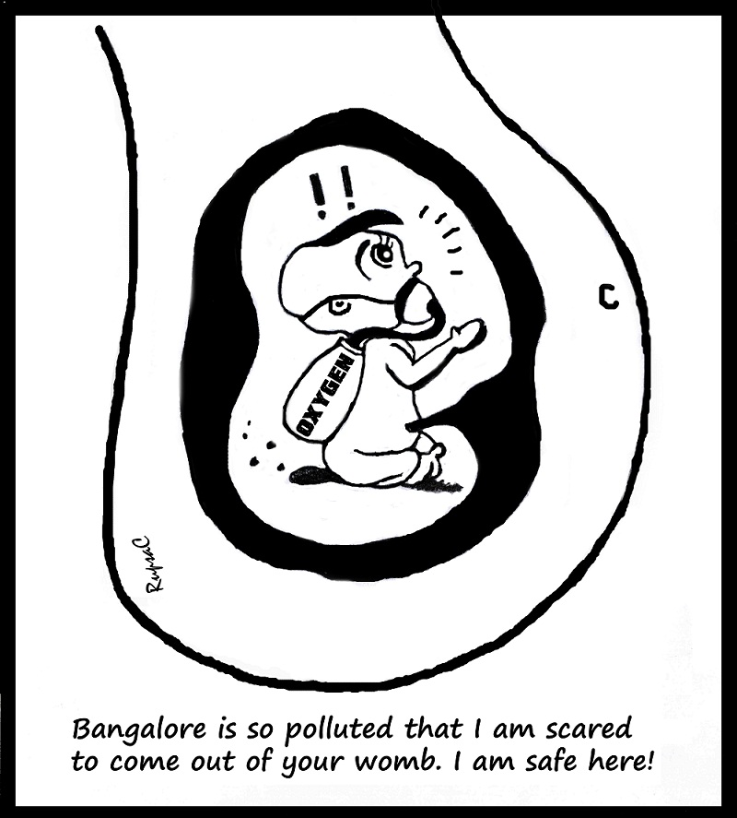
Air quality status?

Slide 8
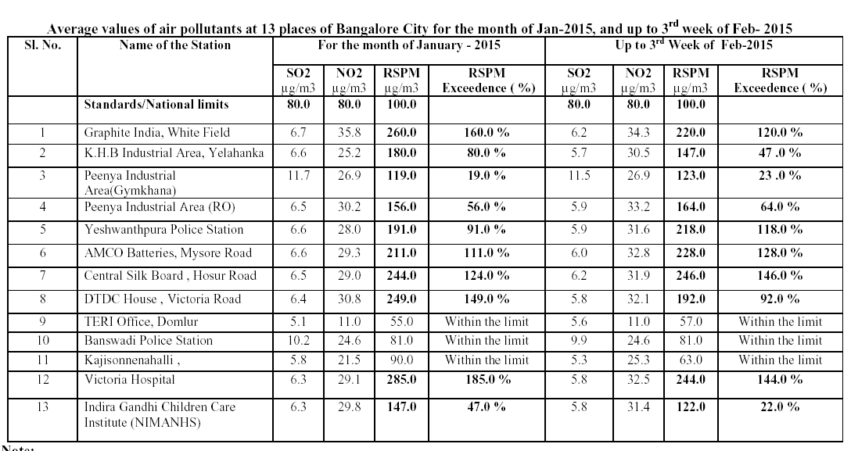

Slide 9
Unique topographical terrains
North Bengaluru is having flat terrains
South Bengaluru uneven landscape with intermingling hills and valleys
average elevation of 900m
Road length- 11,000 km
Weak/No- Public suburban rail/metro transport seats
Public bus transport/1000 population-35, para-public-352
Notes:
During 1981-2011, decadal growth is 65% in Bengaluru

Slide 11
Other reasons
Uncontrolled growth of vehicular population
Type of vehicles on road (predominant old vehicles, Bharat Stage – II vehicles, 2W / 3W)
Fuel quality issues
Fuel adulteration issues
Air pollution from SSI units (brick kiln, stone crusher, hotmix plants etc.)
Large number of DG Sets (small power generating set run on liquid fuel)

Slide 12
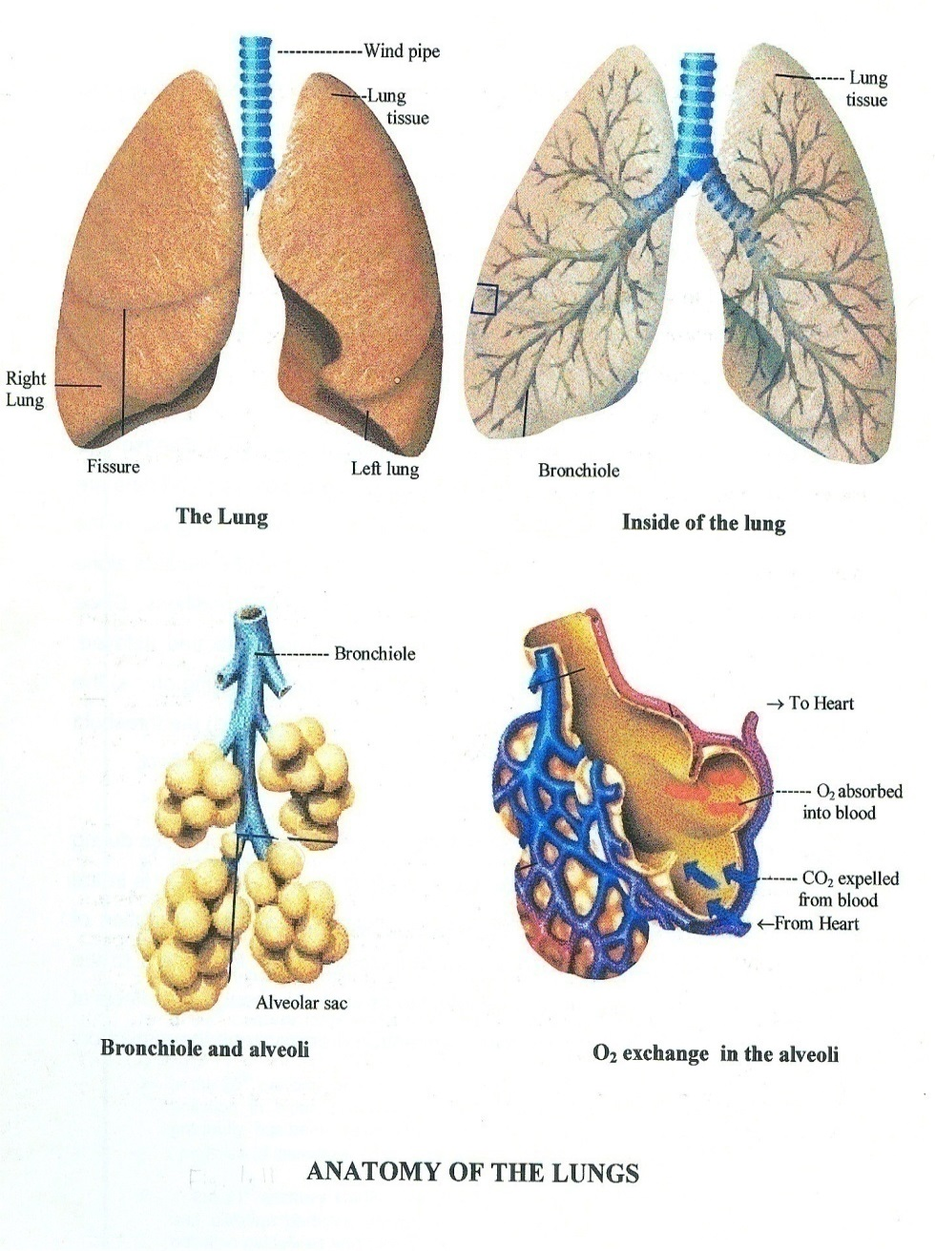
Lung - the main entry point of air pollutants, and the target organ is the alveolus. (There are 300 million alveoli in human lungs)
10,000 – 15,000 litres air enters every day in an adult lung.
Increase in the concentration of pollutants cause parallel increase in the toxic insult to the lungs
From the alveolus, pollutants travel via lymph or blood to different organs.
Route of Invasion
Notes:
12

Slide 13
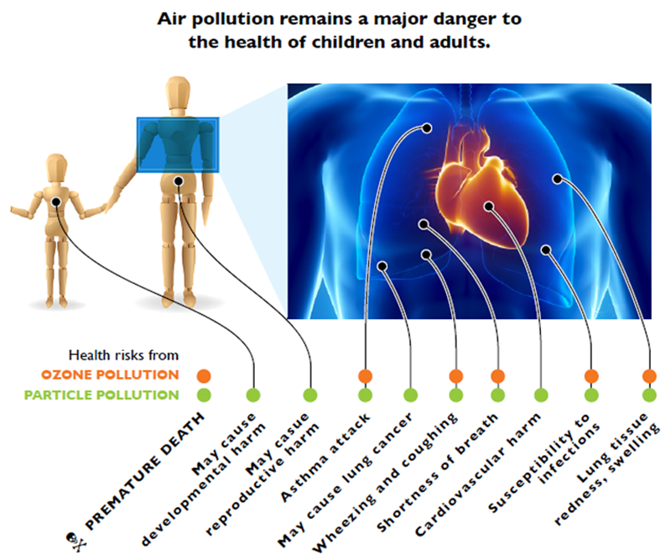

Slide 14
Important Provision of Air Act, 1981
Function of Central Board under section 16(2)
Advice the central government on any matter concerning the improvement of the quality of air and the prevention, control or abatement of air pollution,
Plan and cause to be executed a nation vide programme for the prevention, control or abatement of air pollution;
Co-ordinate the activities of the State and resolve disputed among them;
Provide technical assistance and guidance to the State Boards, carry out and sponsor investigations and research relating to problems of air pollution and prevention, control or abatement of air pollution;
Plan and organise the training of persons engaged or to be engaged in programmes for the prevention, control or abatement of air pollution on such terms and conditions as the Central Board may specify;

Slide 15
organise through mass media a comprehensive programme regarding the prevention, control or abatement of air pollution;
collect, compile and publish technical and statistical data relating to air pollution and the measures devised for its effective prevention, control or abatement and prepare manuals, codes or guides relating to prevention, control or abatement of air pollution;
lay down standards for the quality of air;
collect and disseminate information in respect of matters relating to air pollution;
perform such other functions as may be prescribed

Slide 16
Function of State Pollution Control Boards under section 17(1)
To plan a comprehensive programme for the prevention control or abatement of air pollution and to secure the execution thereof;
To advice the state government on any matter concerning the prevention control or abatement of air pollution;
To collect and disseminate information relating to air pollution;
To collaborate with central board in organising the training of persons engaged or to be engaged in programmes relating to prevention, control or abatement of air pollution and to organise mass education programme relating thereto;
To inspect, at all reasonable times, any control equipment, industrial plant or manufacturing process and to give, by order, such direction to such person as it may consider necessary to take step for the prevention, control or abatement of air pollution;

Slide 17
To inspect air pollution control areas at such intervals as it may think necessary, assess the quality therein and take steps for the prevention, control or abatement of air pollution in such areas
To lay down in consultation with Central Board and having regard to the standards for the quality of air laid down by the Central Boards, standards for the emission of air pollution into the atmosphere from industrial plants and automobiles or for the discharge of any air pollutants into the atmosphere from any other source whatsoever not being a ship or an aircraft; provided the different standards for emission may be laid down under the clause for different industrial plants having regard to the quantity and composition of emission of air pollutants into the atmosphere from such industrial plants;
To advice the state government with respect to the suitability of any premises or location for carrying on any industry which is likely to cause air pollution;
To perform such other functions as may be prescribed by the central board or the state government;

Slide 18
Section 18 of Air Act – Power to give directions
In the performance of its function under this act
The central board shall be bound by such directions in writing as the central government may give to it; and
Every state board shall be bound by such direction in writing as the central board or the state government may give to it;
Section 19 – Power to declare air pollution control areas
The State Government may, after consultation with the State Board, by notification in official gazette declared in such manner as may be prescribed, any area or areas within the State as air pollution control area or areas for the purposes of this act.

Slide 19
Section 31 (A) of Air Act – Power to give directions
Notwithstanding anything contained in any other law, but subject to the provsions of this Act, and to any directions that Central Government may give in this behalf, a Board may, in the exercise of its powers and performance of its functioning under this Act, issue any directions in writing to any person, officer or authority, and such person, officers or authority shall be bound to comply with such directions.
Explanation : for the avoidance of doubts, it is hereby declared that the power to issue directions under this section, includes the power to direct –
The closure, prohibition or regulation of any industry, operation or process ; or
The stoppage or regulation of supply of electricity, water or any other service.

Slide 20
AMBIENT AIR QUALITY STANDARDS 2009
S.No. | Pollutant | Time Weighted Average | Concentration in Ambient Air |  | Methods of Measurement | Remarks
 |  |  | Industrial, Residential, Rural and Other Area | Ecologically Sensitive Area (notified by Central Government)
(1) | (2) | (3) | (4) | (5) | (6) | (7)
1. | Sulphur Dioxide (SO₂), µg/m³ | Annual* 24 hours** | 50 80 | 20 80 | a) Improved West and Gaeke b) Ultraviolet fluorescence | Facilities available
2. | Nitrogen Dioxide (NO₂), µg/m³ | Annual* 24 hours** | 40 80 | 30 80 | a) Modified Jacob & Hocheiser (Na-Arsenite) b) Chemiluminiscence | Facilities available
Contd..
Notes:
20

Slide 21
3. | Particulate Matter (size less than 10 µm) or PM₁₀ µg/m³ | Annual* 24 hours** | 60 100 | 60 100 | a) Gravimetric b) TOEM c) Beta attenuation | Most of the NAMP Stations have Gravimetric measurement facility including CPCB CAQMS is having BAM TEOM has to be introduced gradually
4. | Particulate Matter (size less than 2.5 µm) or PM_{2.5} µg/m³ | Annual* 24 hours** | 40 60 | 40 60 | a) Gravimetric b) TOEM c) Beta attenuation | Gravimetric measurement facility may be developed countrywide CAQMS is having BAM TEOM is yet to be introduced gradually
5. | Ozone (O₃) µg/m³ | 8 hours* 1 hour** | 100 180 | 100 180 | a) UV photometric b) Chemiluminiscence c) Chemical Method | CAQMS equipped with UV based or Chemiluminescence Online Analysers and may be used for 1 hrly data Chemical method may be adopted nationwide but monitoring hours is not specified, however 09 hrs to 17 hrs may be introduced

Slide 22
6. | Lead (Pb) µg/m³ | Annual* 24hours** | 0.5 1.0 | 0.5 1.0 | a) AAS/ICP method after sampling on EPM 2000 or equivalent filter paper b) ED-XRF using Teflon filter | It appears that Pb is to be monitored in PM₁₀, this standard already exists but monitored in SPM only at few locations. Once the sampling is done in Teflon the same may also be analyzed by other method ED-XRF
7. | Carbon Monoxide (CO) µg/m³ | 8 hours* 1 hour** | 02 04 | 02 04 | Non Dispersiv Infra Red (NDIR) spectroscopy | Only option is to go with online analyzer
8. | Ammonia (NH₃) µg/m³ | Annual* 24hours** | 100 400 | 100 400 | a)Chemiluminiscence b) Indophenol blue method | Recently introduced at few locations in CAQMS Chemical method may be adopted nationwide
9. | Benzene (C₆H₆) µg/m³ | Annual* | 05 | 05 | a)Gas chromatography based continuous analyzer b) Adsorption and Desorption followed by GC analysis | BTX analysers are being used at CAQMS Active 24 hourly sampling in diffusion tubes followed by desorption in CS₂ and finally GC Analysis may be adopted nationwide in NAMP

Slide 23
10. | Benzo(a)Pyrene (BaP) – particulate phase only, ng/m³ | Annual* | 01 | 01 | Solvent extraction followed by HPLC/GC analysis | Facilities available with CPCB but BIS method using GC-FID may not attain the desired lowest concentration level below 1ng/m³ alternatively GC-MS or HPLC-UV Fluorescence may be provided
11. | Arsenic (As), ng/m³ | Annual* | 06 | 06 | AAS/ICP method after sampling on EPM 2000 or equivalent filter paper | It appears that ‘As’ is to be monitored in PM₁₀. Micro-wave digester is required for digestion alternatively acid digestion at 70⁰ C for 12 hours is required.
12. | Nickel (Ni), ng/m³ | Annual* | 20 | 20 | AAS/ICP method after sampling on EPM 2000 or equivalent filter paper | It appears that ‘Ni’ is to be monitored in PM₁₀. Micro-wave digester is required for digestion alternatively acid digestion at 70⁰ C for 12 hours is required.

Slide 24
National Ambient Air Quality Monitoring
four air pollutants viz ., Sulphur Dioxide (SO₂), Oxides of Nitrogen as NO₂, and Respirable Suspended Particulate Matter (RSPM / PM10) are regularly monitored at all the locations along with meteorological parameters such as wind speed and wind direction, relative humidity (RH) and temperature were also integrated with the monitoring of air quality.
monitoring is carried out for 24 hours (4-hourly sampling for gaseous pollutants and 8-hourly sampling for particulate matter) with a frequency of twice a week, to have one hundred and four (104) observations in a year.

Slide 25
13 NAMP stations
Three CAAQM stations
Bengaluru is identified as one of the non-attainment cities w.r.t ambient air quality (PM₁₀).

Slide 26
Short term study was carried out to assess the ambient air quality in Bengaluru
12 air pollutants were analysed at seven locations from September 2013 to March 2014
Though few parameters were exceeding in few locations at some part of time, but the monitoring has to be carried out regularly.

Slide 27
Chemical characterization anions, cations & PAH on ambient particulate
analysed the chemical composition of ambient particulate matter with respect to PAH, anions and cations to identify the sources of pollution so as to control pollution at source
Samples were extracted from filter papers, concentrated for PAH and then analysed using Gas Chromatograph equipped with Flame Ionisation Detector.
Transport sector, road dust re-suspension and construction activity are major contributors
Concerned stakeholders are directed to devise action plan

Slide 28
Air Quality Index
The AQI system is based on maximum operator of a function (i.e. selecting the maximum of subindices of individual pollutants as an overall AQI)
Eight parameters (PM₁₀, PM_{2.5}, NO₂, SO₂, CO, O₃, NH₃, and Pb)
quickly disseminate information and associated health risks to public
For continuous air quality stations, AQI is reported in near real-time for as many parameters as possible. For manual stations, the daily AQI is reported with a lag of one week air quality information

Slide 29
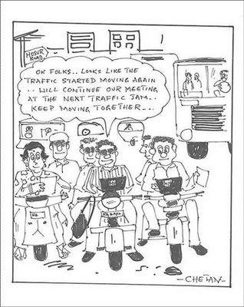
Vehicular Pollution

Slide 30
Emission norms for passenger cars
 | CO (g/km) | HC+Nox(g/km)
BS-II | 2.2 | 0.5
BS-III | 2.3 | 0.35 (combined)
BS-IV | 1.0 | 0.18 (combined)
Emission norms for 2/3 wheelers
2000 norms | 2 | 2
BS-II | 1.6 | 1.5
BS-III | 1.0 | 1.0
Emission norms for Heavy Diesel Vehicles
 | CO (g/kmhr) | HC(g/kmhr) | Nox (g/kmhr) | PM (g/kwhr)
BS-II | 4.0 | 1.1 | 7.0 | 0.15
BS-III | 2.1 | 1.6 | 5.0 | 0.1
BS-IV | 1.5 | 0.96 | 3.5 | 0.02

Slide 31
Auto Fuel Quality
Gasoline specifications
 | 2010
Rvp at 38⁰C Kpa
Benzene % by vol, max | 1.0
Lead G/m3, max | 0.005
Sulphur % by mass, max | 0.015
Aromatics % v/v, Max | 42
Oxygen % by volume, Max | 2.7
Diesel Specifications
Cetane No, min | 51
Sulphur % w/w, Max | 0.035
Distillation T95 | 360
Polyaromatic | 11

Slide 32
Steps taken to control Pollution
Enhance co-ordination among public departments
Pollution under control certificate (PUC) for in-use vehicles (not very effective)
Independent fuel testing laboratories for checking fuel adulteration
Thrust on use of clean transportation fuel (CNG)
Public participation

Slide 33
People-centric service
Vision
Development without Destruction
Progress & Protection should go together
Mission
Clean water, Clean Air and Clean Energy to All
Increase in green cover to enhance Carbon Sequestration
Transparent Governance
No encroachment of forests and lakes
24x7 monitoring of industrial chimney
plastic carrybag free India

